Slide 1
Manual of DAB3 Model for PGS
With three operating modes: SPS, ADCC and IADCC.
Huixue Liu

Slide 2
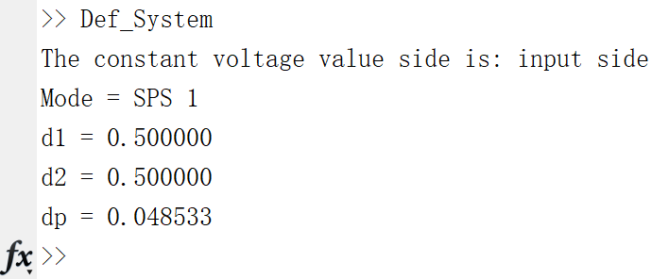
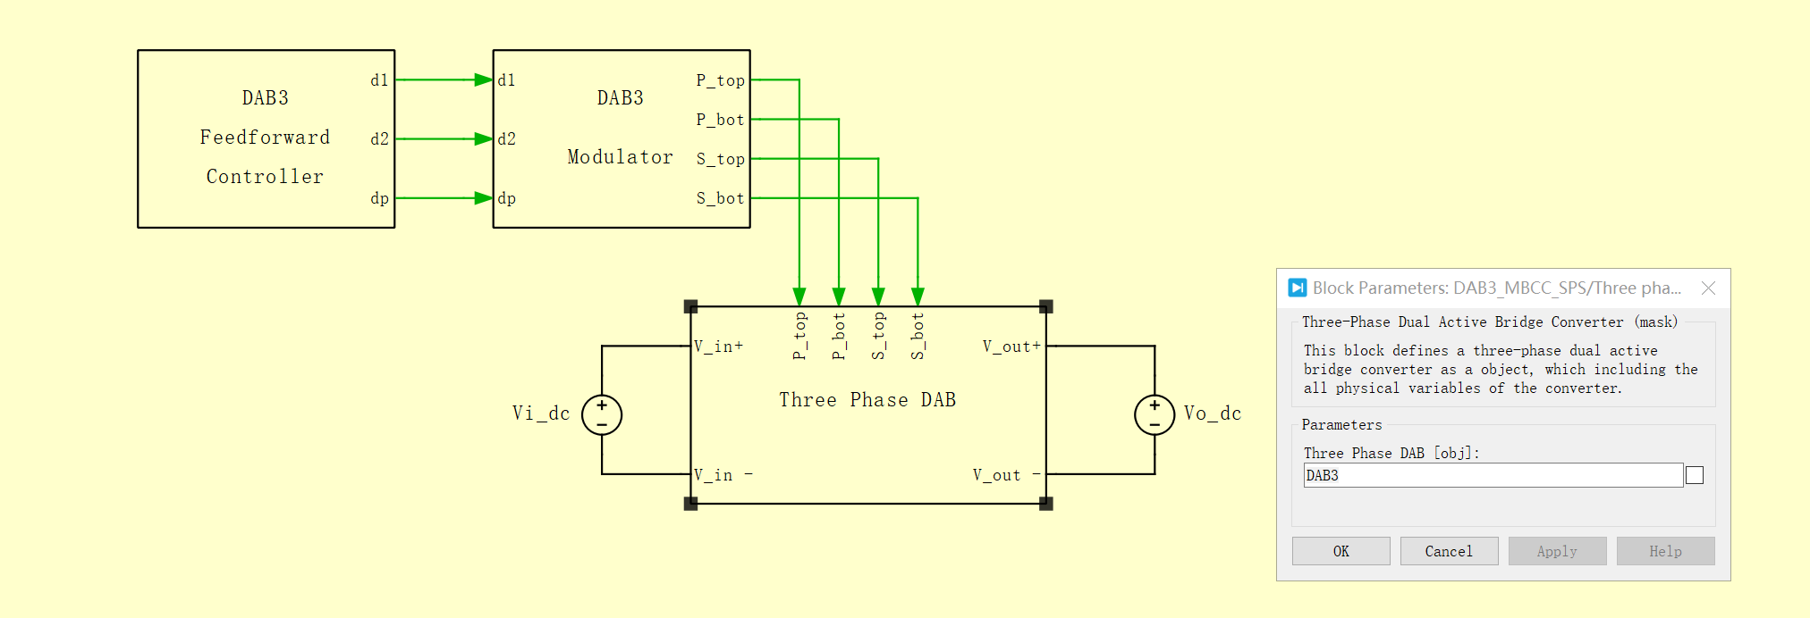
How to Run the Model
Step 1: Run the file: Def_System.m
Get primary side duty cycle d1
Get secondary side duty cycle d2
Get phase shifting dp
Step 2: Run the model in PLECS: DAB3_MBCC.slx
All modules can directly call the objects of the file.
i.e.: call DAB3 object

Slide 3
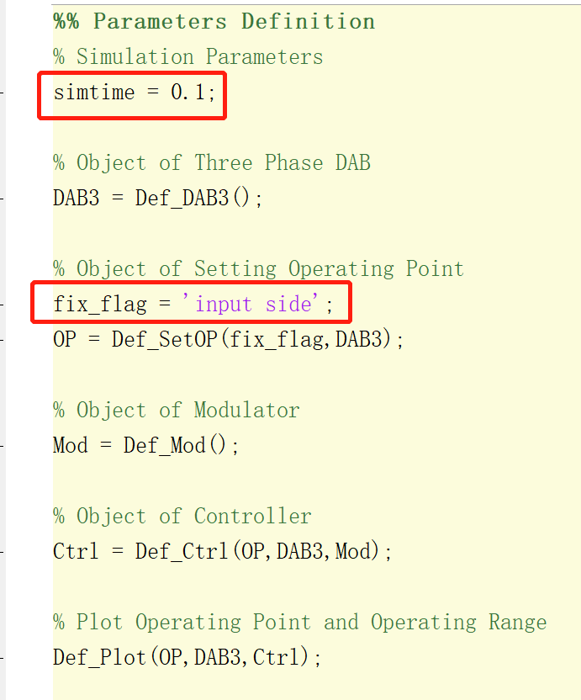
How to Set Operating Point
Step 1: Open the main file: Def_System.m
All the variables in the circuit will be defined here using Object-Oriented Methods. Here you can:
Set the simulation duration with simtime ;
Set the fixed-voltage value side with fix_flag ;
i.e.: fix_flag = 'input side‘; that means the input voltage has a fixed value, and the output voltage will be influenced by the other parameters.

Slide 4
How to Set Operating Point
Step 2: Open the file: Def_SetOP.m
Set power value
Set the power rating with OP.Pn;
Set the power flow in per-unit system with OP.P_op ;
Set voltage value
Set the fixed-voltage side value with OP.V_fix ;
Set the voltage ratio in per-unit system with OP.r_op ;
The operating input and output voltage will be calculated according to the above settings.

Slide 5
How to Set Other Objects
Step 3: Open the file: Def_DAB3.m
Set the Three-Phase-DAB parameters as required;
Initial voltage of capacitors depends on the OP.Vn_in and OP.Vn_out in Def_SetOP.m file.
Step 4: Open the file: Def_Mod.m
Set the dead time parameters in modulator object;
Decide whether to use ICC mode with Mod.ICC_flag .
Choose the different dead time mode with Mod.td_mode .

Slide 6
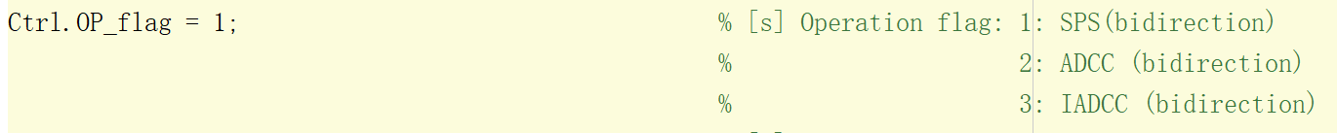
How to Set Other Objects
Step 5: Open the file: Def_Ctrl.m
Set the switching frequency with Ctrl.f and sampling frequency with Ctrl.f_samp in controller object;
Decide whether to use dead time compensation with Ctrl.td_flag.
Choose the different operating mode with Ctrl.OP_flag .

Slide 7
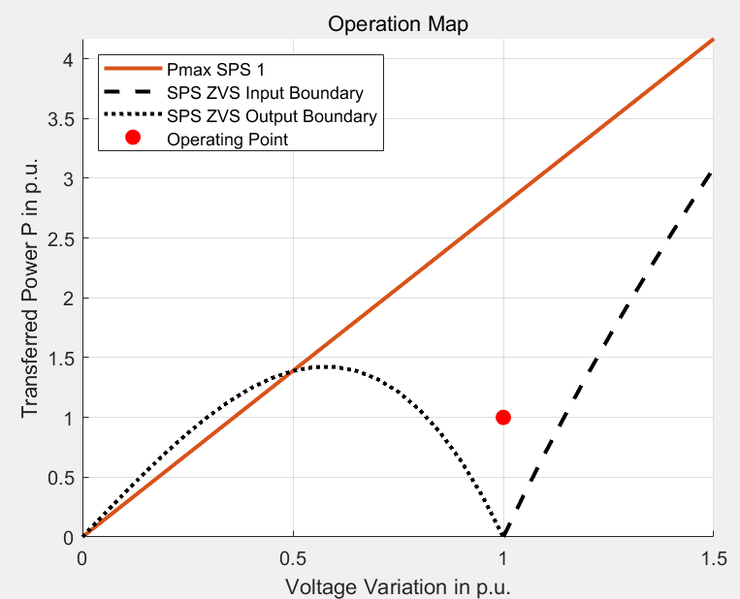
How to Set Other Objects
Step 6: File Def_Plot.m
Show the operating point and the operating range of the circuit;
Without modification.

Slide 8
Kontakt
E.ON Energy Research Center
Mathieustraße 10
52074 Aachen
Germany
VORNAME NACHNAME
T +49 241 80 49xxx
F +49 241 80 49xxx
xxx@eonerc.rwth-aachen.de
Further Information:
http://www.eonerc.rwth-aachen.de

